Slide 1

AI driven Optimization of Private Blockchain For Health Care Data Sharing
Meet Panchal
60003230306
Dhruv Padhiar
60003230303
Nirav Chesaniya
60003230310
Esha Malavia
60003230304
Under the guidance of
Dr. Ram Mangrulkar
Project Guide
Department of Information Technology
DJSCE
Mumbai University
2023-24

Slide 2
Overview
Problem Definition
Literature Review (Slide 3-5)
Observations and conclusion of Existing Work
System Architecture/ Block Diagram
Project Timeline
References/Learning resources.

Slide 3
Problem Definition
AI driven Optimization of Private Blockchain For Health Care Data Sharing
Problem Definition
In India, healthcare facilities face challenges in securely sharing patient records due to existing systems' inefficiencies. Current blockchain solutions lack optimization, leading to slow transactions and high costs. Ensuring privacy and confidentiality of data remains a concern, while managing blockchain infrastructure poses technical challenges for hospitals.
Our project aims to develop a user-friendly web app powered by AI. This app will enable seamless sharing of health records among clinics and hospitals via a private blockchain optimized for performance and security. By emphasizing availability in Indian hospitals, we aim to overcome existing system limitations, facilitating efficient and secure healthcare data sharing.

Slide 4
Literature Review
"Optimized blockchain-based healthcare framework empowered by mixed multi-agent reinforcement learning" by Abeer Z. Al-Marridi, Amr Mohamed, and Aiman Erbad
Existing Systems: Traditional healthcare data sharing systems suffer from centralized architectures prone to security breaches and inefficiencies in data access and sharing. Additionally, blockchain-based systems may encounter scalability and optimization challenges.
Methodology/Approach: The proposed framework employs mixed multi-agent reinforcement learning (MMARL), where multiple agents interact and make decisions in a dynamic environment. Reinforcement learning algorithms, such as Q-learning or deep Q-networks, enable agents to learn optimal data sharing strategies. These agents represent various stakeholders in healthcare data sharing and learn to optimize sharing while ensuring privacy and security.
Key technologies used include:
Blockchain technology: Utilized for secure and immutable storage of healthcare data.
Multi-agent reinforcement learning (MMARL): Facilitates collaborative decision-making among multiple agents within the healthcare ecosystem.

Slide 5
Literature Review
X. Liu, Z. Wang, C. Jin, F. Li and G. Li, "A Blockchain-Based Medical Data Sharing and Protection Scheme,"
Existing Systems: Current medical data sharing systems often suffer from privacy protection, security, and data integrity issues. Centralized architectures are commonly used, leading to vulnerabilities like single points of failure and unauthorized access. Patient privacy and data misuse concerns are prevalent.
Methodology/Approach: The paper integrates blockchain technology into medical data sharing to address existing shortcomings. It utilizes smart contracts, particularly on platforms like Ethereum, to enforce access control and data sharing policies.Smart contracts are utilized for fine-grained access control, while consensus algorithms may ensure the immutability and integrity of medical records stored on the blockchain.
Key technologies, tools, and frameworks include:
Blockchain technology: Utilized for decentralized storage and management of medical data, ensuring transparency, integrity, and security.
Smart contracts: Automation and enforcement of access control policies, facilitating secure and auditable medical data sharing.
Cryptographic techniques: Encryption algorithms employed to protect medical data confidentiality and prevent unauthorized access.
Consensus algorithms: Proof of Work (PoW) or Proof of Stake (PoS) may be employed to achieve agreement among network participants on transaction validity and blockchain state.

Slide 6
Literature Review
"A Systematic Review on AI-Blockchain Based E-Healthcare Records Management Systems" by A. Haddad, M. H. Habaebi, M. R. Islam, N. F. Hasbullah, and S. A. Zabidi
Existing Systems: The paper reviews current AI-blockchain integration in managing e-healthcare records. It explores systems addressing data security, interoperability, and accessibility challenges. Examples include AI-driven data analysis and blockchain for secure data storage and sharing.
Methodology/Approach: The paper conducts a systematic literature review to identify and assess AI-blockchain based e-healthcare records management systems. It searches and selects relevant articles, papers, and reports. It examines algorithms like machine learning and blockchain consensus for data analysis and security
Technology/Tools/Frameworks:
AI frameworks and libraries: TensorFlow, PyTorch, scikit-learn, and NLTK are examples used for implementing machine learning and NLP algorithms.
Blockchain platforms: Ethereum, Hyperledger Fabric, and Corda are commonly utilized for decentralized data storage, transaction management, and smart contract execution.
Data management tools: MongoDB, MySQL, and PostgreSQL databases may be employed for storing and managing e-healthcare records.

Slide 7
Literature Review
"MedBlock: An AI-enabled and Blockchain-driven Medical Healthcare System for COVID-19" by C. Mistry et al
Existing Systems: The paper examines shortcomings in existing healthcare systems during the COVID-19 crisis, including inefficiencies in data sharing, interoperability issues, and concerns about data security and privacy. It proposes MedBlock as a solution, utilizing AI and blockchain to improve medical healthcare management during pandemics.
Methodology/Approach: The research focuses on developing MedBlock, an AI-enabled and blockchain-driven healthcare system. It integrates AI techniques for data analysis, disease prediction, and decision support, employing machine learning algorithms for tasks like predictive modeling and risk assessment related to COVID-19.
Technology/Tools/Frameworks:
AI frameworks: TensorFlow, PyTorch, or scikit-learn for AI model development and deployment.
Blockchain platforms: Ethereum, Hyperledger, or Corda for secure and decentralized data storage.
Smart contracts: Solidity (for Ethereum) or Chaincode (for Hyperledger Fabric) for developing and deploying smart contracts automating business logic in healthcare systems.

Slide 8
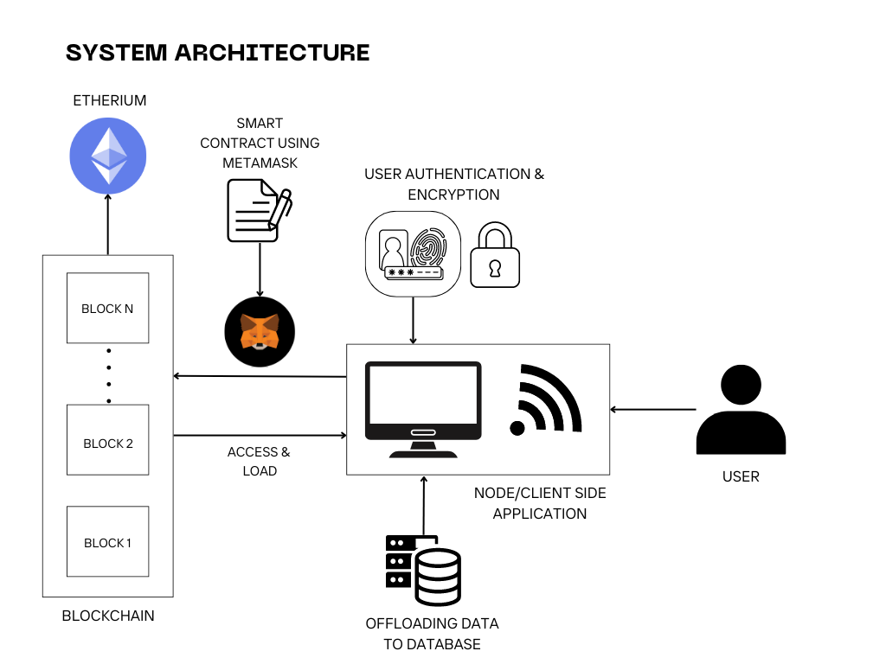
System Architecture/ Block Diagram

Slide 9
Project Timeline
2024
July | Aug | Sept | Oct | Nov | Dec | Jan | Feb | Mar | Apr | May | Jun
Planning and
research
Partial project completion
Project devemopment
Testing and debugging
Deployment
Finalizing

Slide 10
Literature Review
Observations and conclusion of Existing Work
The research papers emphasize the transformative potential of integrating AI and blockchain technologies in healthcare, particularly amid crises like the COVID-19 pandemic. Existing healthcare systems face challenges in data sharing, interoperability, and data security, prompting the development of innovative solutions like MedBlock. By leveraging AI for data analysis and prediction and blockchain for secure data storage and sharing, these systems offer improved efficiency, transparency, and patient care. Moving forward, further exploration and implementation of AI-blockchain solutions hold promise for enhancing healthcare management and resilience in the face of future challenges.

Slide 11
References
Published Literature/ Research Papers,
"Optimized blockchain-based healthcare framework empowered by mixed multi-agent reinforcement learning" by Abeer Z. Al-Marridi, Amr Mohamed, and Aiman Erbad
X. Liu, Z. Wang, C. Jin, F. Li and G. Li, "A Blockchain-Based Medical Data Sharing and Protection Scheme,"
"A Systematic Review on AI-Blockchain Based E-Healthcare Records Management Systems" by A. Haddad, M. H. Habaebi, M. R. Islam, N. F. Hasbullah, and S. A. Zabidi
"MedBlock: An AI-enabled and Blockchain-driven Medical Healthcare System for COVID-19" by C. Mistry et al

Slide 12
Thank You!!!

